Slide 1


Immigration Facts
Answers to questions often asked about immigration ...

Slide 2
Immigration History?
Immigration is not new!
Migrant Labor in Wisconsin
  Began in the 1920s and 1930s
  At its peak, 20,000 seasonal workers per year
  Planted and harvested agricultural crops
  April to November
Some chose to live here, build a life and become citizens
Today, No path to citizenship for most undocumented immigrants.

Slide 3
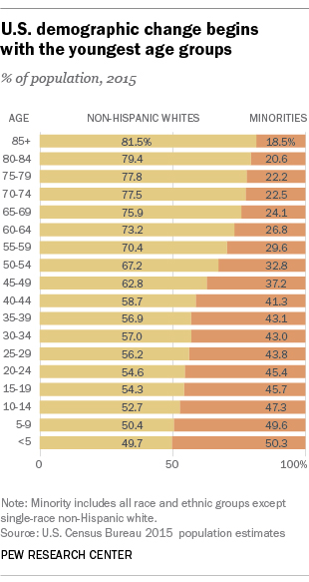
Hispanic Population?
58.9 million (18.1%) of US population in 2015
  Largest ethnic minority in the US
  Source: US Census Update 6/21/18
23.2% of US babies were born to Hispanic mothers in 2015
  924,048 of 3,978,497 babies born in the US
  Source: Henry J Kaiser Family Foundation

Slide 4
How Many Undocumented Immigrants?
11 million undocumented immigrants in the US * (Source: Pew Research)
  40% of unauthorized immigrants overstayed their visa (Source: Sesini Law Firm)
  60% crossed the border without authorization
  Pay $11.64 Billion in State & Local Taxes (Source: The Institute of Taxation & Economic Policy, 2016)
71,000 undocumented immigrants in WI in 2014 (Source: Migration Advocacy Network)
  Pay $17.8 Million in Wisconsin State & Local Taxes
* - These numbers do not include natural born citizens, naturalized citizens, lawful permanent residents, or lawful temporary residents.

Slide 5
Nation of Origin - Unauthorized Immigrants? (Source: Pew Research)
Country or Region | People (Millions) | Percent
Mexico | 5.550 | 50.0%
Other Latin American Countries | 2.875 | 26.6%
All other Countries | 2.575 | 23.4%
8.425 million Hispanic unauthorized immigrants
Account for 14.3% of the nation’s total Hispanic population.
India and China surpassed Mexico as top origin countries of the nation’s immigrants in 2013.

Slide 6
Army of Immigrants?
Source: US Border Patrol
Border Patrol: Apprehensions
  44-year low in 2015
  46-year low in 2017
Annual apprehension data
2000 | 2015 | 2017
1,676,438 | 337,117 | 310,531
81.5% decrease in apprehensions
by US Border Patrol

Slide 7
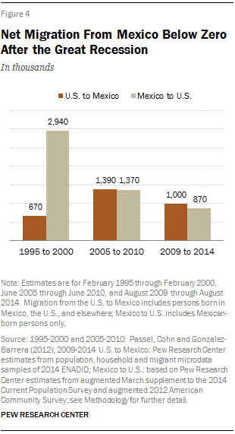
Net Migration Trend?
Source: Pew Research
More people have left for Mexico than come to the US since 2005!
  Net migration of about 150,000 people from the US to Mexico.

Slide 8
How Long Have They Lived Here?
2014
13.6 Years: median time unauthorized immigrants lived in the US in 2014
Source: Pew Research
2018
16.8 Years: median time unauthorized immigrants lived in the US in 2018

Slide 9
Immigrant Families?
Source: Pew Research
UNDOCUMENTED IMMIGRANT ADULTS LIVING WITH US BORN CHILDREN *
YEAR | PEOPLE | PERCENT
2000 | 2.1 million | 30%
2014 | 4.4 million | 39%
Due to mixed citizenship, deportations have dire effects on otherwise strong family units
Includes children that may be either minors or adults.
US born children are US citizens

Slide 10
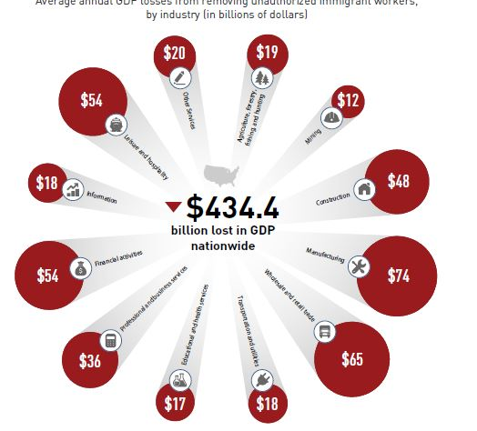
Cost of Mass Deportation?
Source: fwd.us
Average annual GDP losses of $434.4 Billion from removing unauthorized immigrant workers, by industry (in billions of dollars)
$400 to $600 billion cost to U.S. taxpayers if our current broken immigration laws were enforced and all 11 million undocumented immigrants in the United States were deported.

Slide 11
How Many “Dreamers”?
Deferred Action for Childhood Arrivals (DACA), or “Dreamers”
  Children brought to the US prior to 2007
Obama created on 6/2012
  1.1 million Immigrant children
    10% of Undocumented Immigrants
  PEW: 800,000 participated (78%)
Trump ended on 9/2017
  Scheduled end: 3/5/18
  Currently in courts

Slide 12

How Many Local “Dreamers”?
Wisconsin: 17,000 Dreamers
Casa ALBA: 425 Dreamers
  Can currently reapply
  $495 every two years
  Currently in a state of flux
  Enormous fear

Slide 13
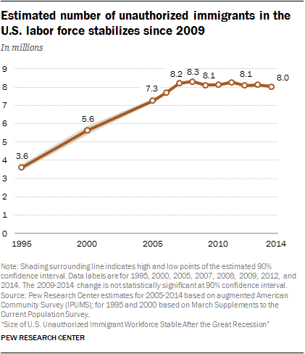
Immigrants and Jobs?
Our economy is at (4%) full employment.
  6.9 million (4.4%) unfilled job openings in the US.
8 million (5%) jobs were filled by undocumented immigrants in the US workforce in 2014.
Currently, too many jobs for too few people!
UNEMPLOYMENT RATE
US | WI | Brown County
3.7% | 3.1% | 2.9%

Slide 14
Drug Crisis and Immigrants
No one wants drug dealers poisoning our children
Undocumented immigrants have more to lose if they deal drugs
A felony conviction:
Deported on jail release,
A lifetime ban on receiving a green card.
Serve jail time,

Slide 15
Attacking Our Drug Crisis?
Source: The Center for Disease Control
DRUG DEATHS | 2000 | 2016 | PERCENT
Total Deaths | 17,415 | 63,632 | 365%
Prescription Opioid Deaths | 4,400 | 32,445 | 737%
Opioids caused 42,249 deaths, or 66% of the total drug deaths, in 2015
  State Department says opioids are domestically produced
The Prescription Opioid epidemic
  77% of opioid overdose deaths
  51% of total drug deaths
Provisional 2017 drug deaths: 72,306
  Other Synthetic Opioid Deaths (primarily Fentanyl) are on rise:
  2014: <5,000 | 2015: <10,000 | 2016: 19,413 | 2017: 29,406

Slide 16
Drug Crisis and Hispanics?
Source: Center for Disease Control
In 2015, the overall drug overdose death rate (per 100,000 people) was:
Whites | Blacks | Hispanics
21.1 | 12.2 | 7.7

Slide 17
Crime and Immigrants
Source: Cato Institute
Immigrants commit fewer crimes than the native population.
Cato Institute
  Libertarian think tank
  Founded by Charles Koch in 1974
Incarceration rate – 2016 (Native vs Immigrant pop.)
  Natives are 5 times more likely to be incarcerated than Legal immigrants
  Natives are 2 times more likely to be incarcerated than Undocumented immigrants

Slide 18
American opinions?
Source: January 2018 Pew Research study
74% of the American public favor granting permanent legal status to DACA “Dreamers”.
60% of the American public oppose “substantially expanding the wall along the US border with Mexico”.

Slide 19
Wisconsin Opinions on Dreamers?
Source: March, 2018 Marquette University survey

Slide 20
Wisconsin Opinions on Immigrants?
Source: March, 2018 Marquette University survey

Slide 21
What can I do?
Research the issue, Understand the facts & Educate others
Join us in advocating for:
  Drivers Card, Clean “Dream Act” & Comprehensive Reform
Exercise your civic responsibility - VOTE!
  Politicians will overlook Hispanic issues until we tell them it is important!
2016 Voter Turn-out Rate by Race & Ethnicity
WHITE | BLACK | HISPANIC
64.7% | 59.9% | 44.9%

